Slide 1
Cross Joins On SQL
The Power of Combining Data
By Atumonye James (MIP-DA-08)

Slide 2
What is a Cross join ?
Cross joins, is a fundamental operation in relational databases, offer a powerful mechanism for generating all possible combinations of rows from two tables.
It Returns all matching records from both tables whether the other table matches or not. So, if there are rows in "Customers" that do not have matches in "Orders", or if there are rows in "Orders" that do not have matches in "Customers", those rows will be listed as well.

Slide 3
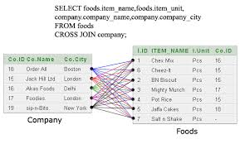

Slide 4
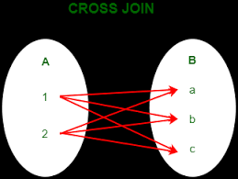

Slide 5
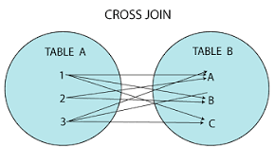

Slide 6
Understanding Cross Joins
At its core, a cross join produces a Cartesian product of two tables, combining each row from the first table with every row from the second table. This results in a dataset where each row from the first table is paired with every row from the second table, creating a complete set of all possible combinations.

Slide 7
Generating Comprehensive Data
Cross joins are invaluable when we need to explore all possible relationships between datasets. Whether we're analyzing product combinations in e-commerce, creating scheduling scenarios in project management, or conducting market research to understand customer preferences, cross joins empower us to generate exhaustive datasets that capture every conceivable combination.

Slide 8
Driving Insights and Decision-Making
By leveraging cross joins, we can uncover hidden patterns, identify correlations, and extract insights that drive informed decision-making. Whether it's identifying potential cross-selling opportunities, optimizing resource allocation, or exploring hypothetical scenarios, the comprehensive datasets produced by cross joins serve as invaluable assets in our analytical endeavors.

Slide 9
The End.

